Slide 1
One Smali Step for Man,
One Big step for researchers
github: huuck twitter: @hookgab

Slide 2
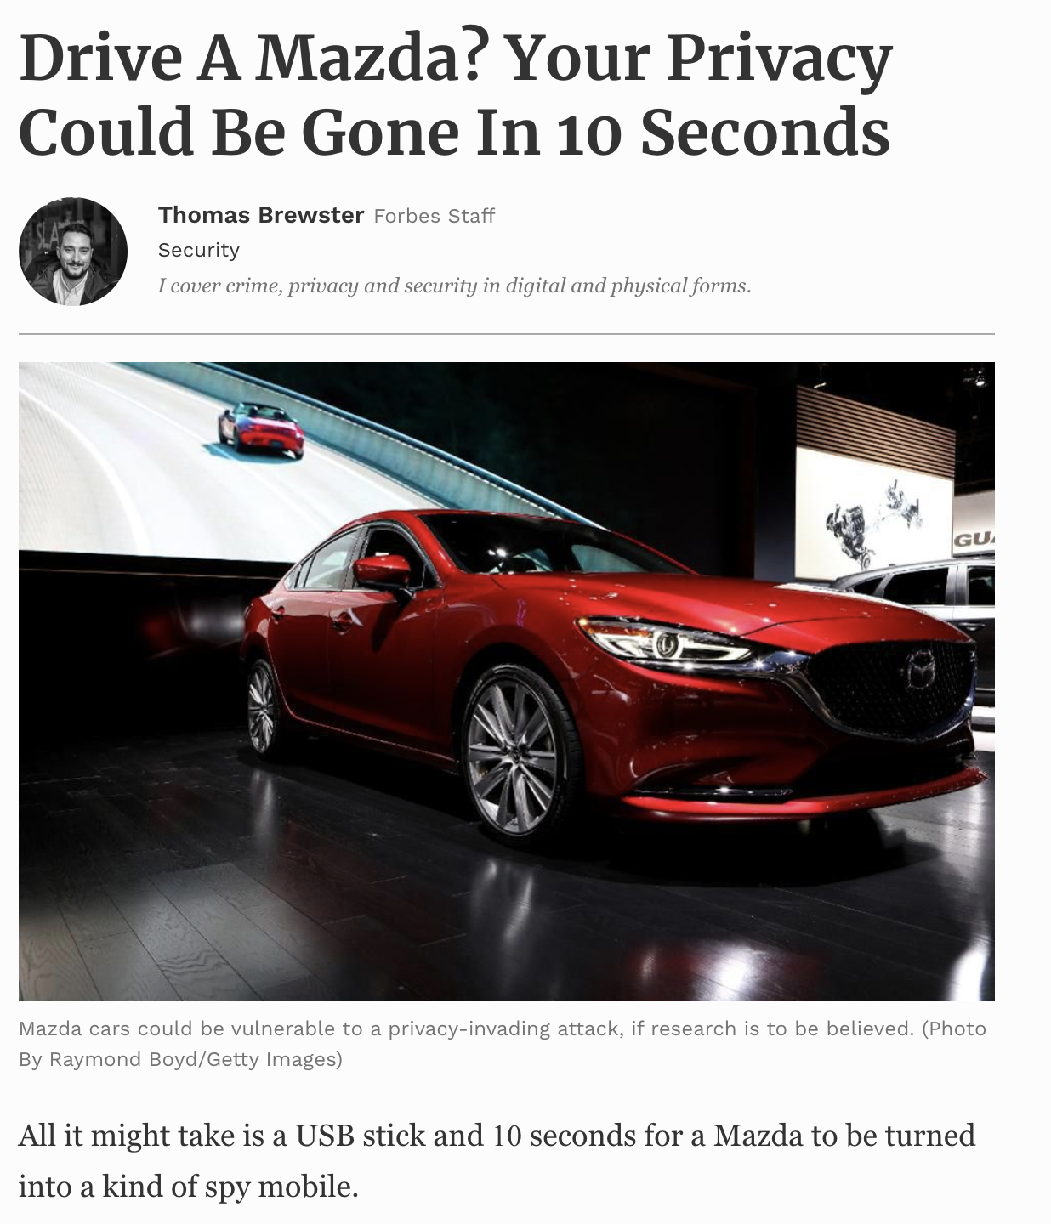

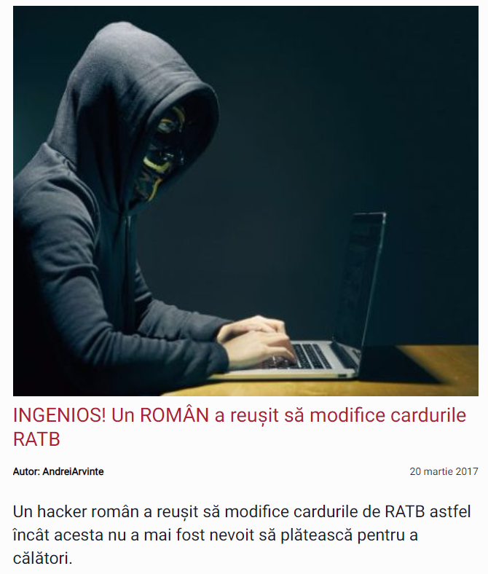
whoami
INGENIOUS! A ROMANIAN managed
to modify public transportation cards!

Slide 3
RATs
Entrypoint Activity
Boot & Persistence receiver
C2
SMS module
Calls module
C2 command receiver
Overlays module
Notifications module
Accessibility module

Slide 4

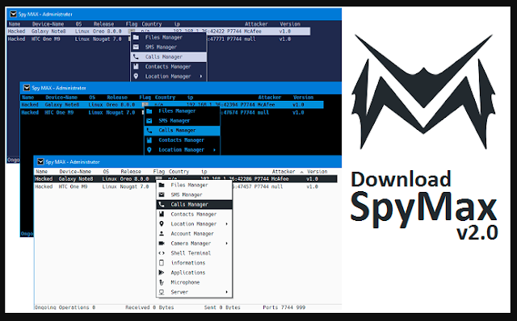
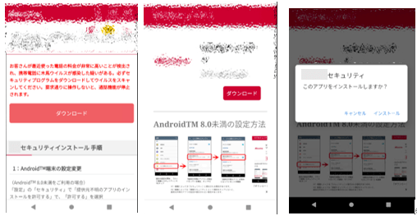
RATs

Slide 5
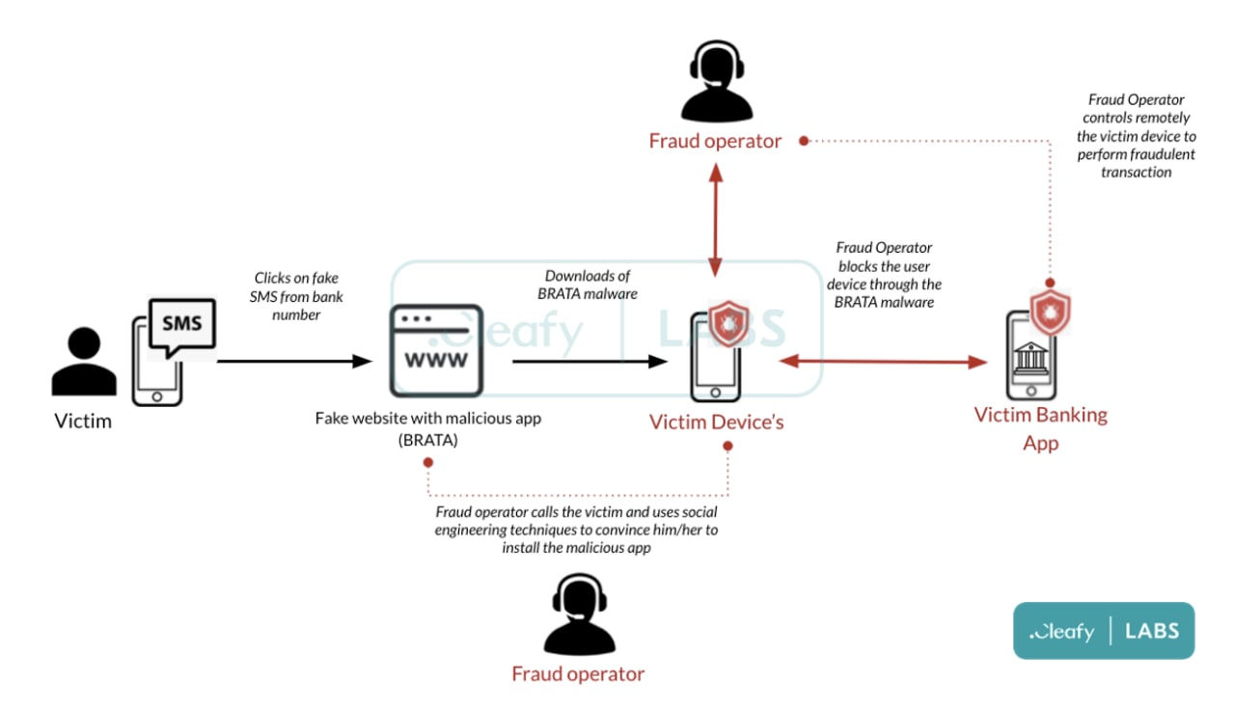
BRATA

Slide 6

Joker

Slide 7
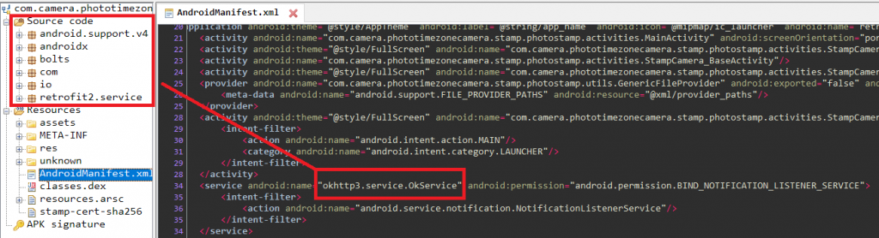
Joker

Slide 8
Joker

Slide 9
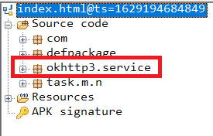
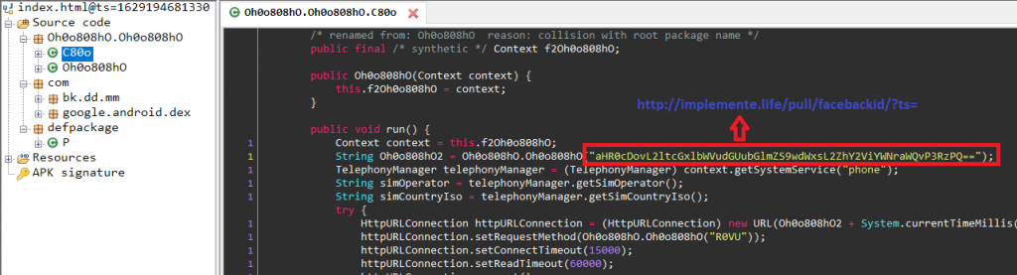
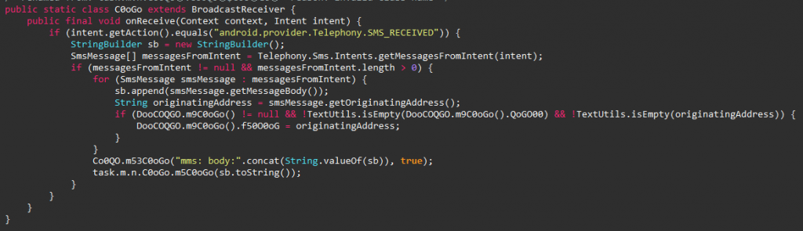
Joker

Slide 10
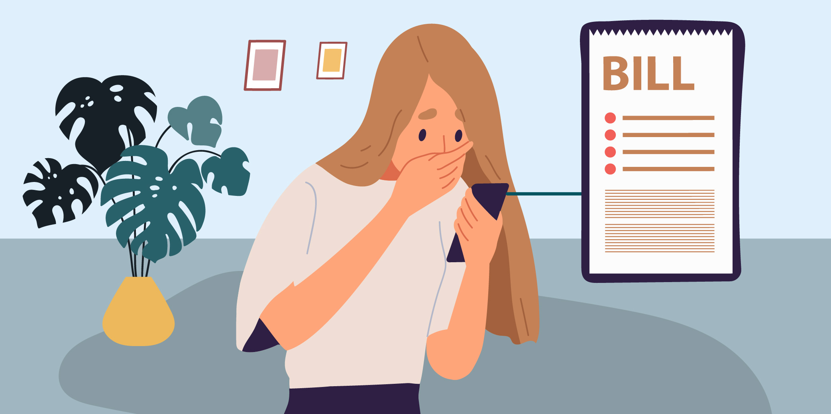
Joker

Slide 11
Android PacKage
META-INF
APK’s passport, any tamper of a resource should be reflected in this folder
AndroidManifest.xml
APKs visa – declares the permissions it will require, activities, services and any other components
classes.dex
classes2.dex
classesN.dex
assets
APKs baggage. Contains videos, images, sound bytes and any other non standard resource
res
APKs baggage for standard resources, such as XML and nine-patch images
lib
native libraries that get executed at runtime through calls from Java land

Slide 12
AndroidManifest.xml
uses-permission
APK’s passport, any tamper of a resource should be reflected in this folder
application
Topmost entrypoint executed when the APK is loaded (most of the time it means it the launcher
icon was tapped)
activity
Visual entities displayed. There will mostly be be a main activity serving as the entrypoint.
Intent-filter
receiver
System wide event listener. Responds and acts on when intents are dispatched.
Intent-filter
service
Android’s way of doing continuous background processing
Intent-filter

Slide 13
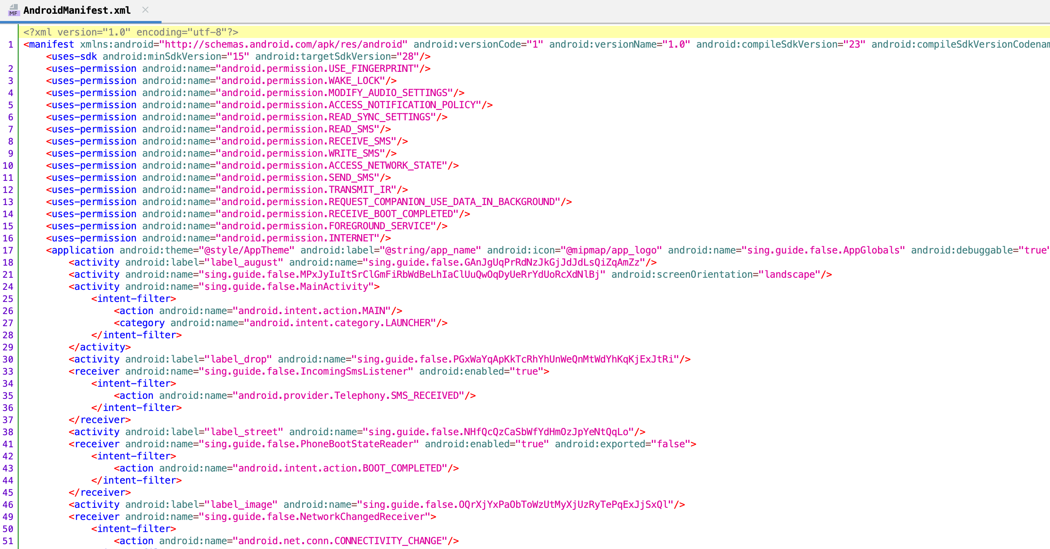
AndroidManifest.xml

Slide 14
Exercise 1
Why can’t I find all the entrypoints in the manifest?

Slide 16
DEX files
classes1.dex
User taps on launcher icon
Is the app already loaded?
classes2.dex
classes.dex
classesN.dex
Application.onCreate()
Activity.onCreate()
Load individual .dex files

Slide 17
DEX files
onCreate(…)
onBind(…)
onStart()
onServiceConnected()
onAccessibilityEvent(…)
onReceive(…)

Slide 18
DEX files
http(s)://
((25[0-5]|2[0-4][0-9]|[01]?[0-9][0-9]?)\.){3}(25[0-5]|2[0-4][0-9]|[01]?[0-9][0-9]?)
loadUrl(
URL(

Slide 19
Exercise 2
What does the malware do? Why can’t use find the C2?

Slide 20
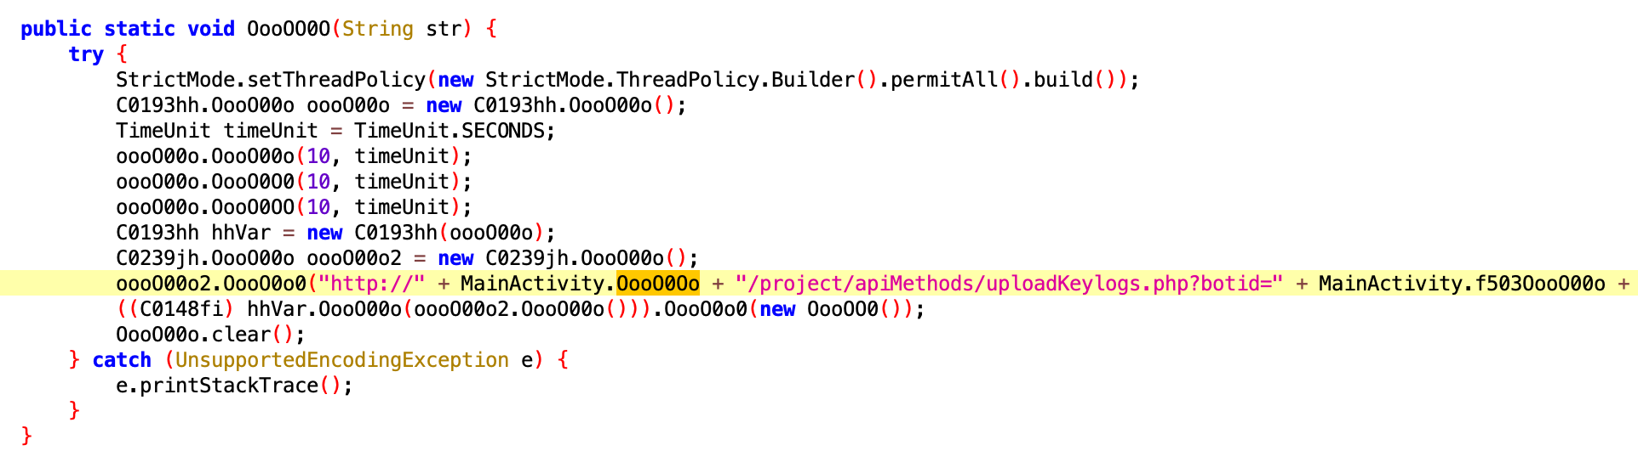
Obfuscation
http(s)://

Slide 21

Obfuscation
Identify obfuscated string
Identify its dependencies
Paste into Java wrapper
…
Profit!

Slide 22
Exercise 3
Find the C2 and deobfuscate it

Slide 23
Dynamic
analysis

Slide 24


Dynamic Analysis
Install Charles
Deploy emulator
Launch app
…
Profit!

Slide 25
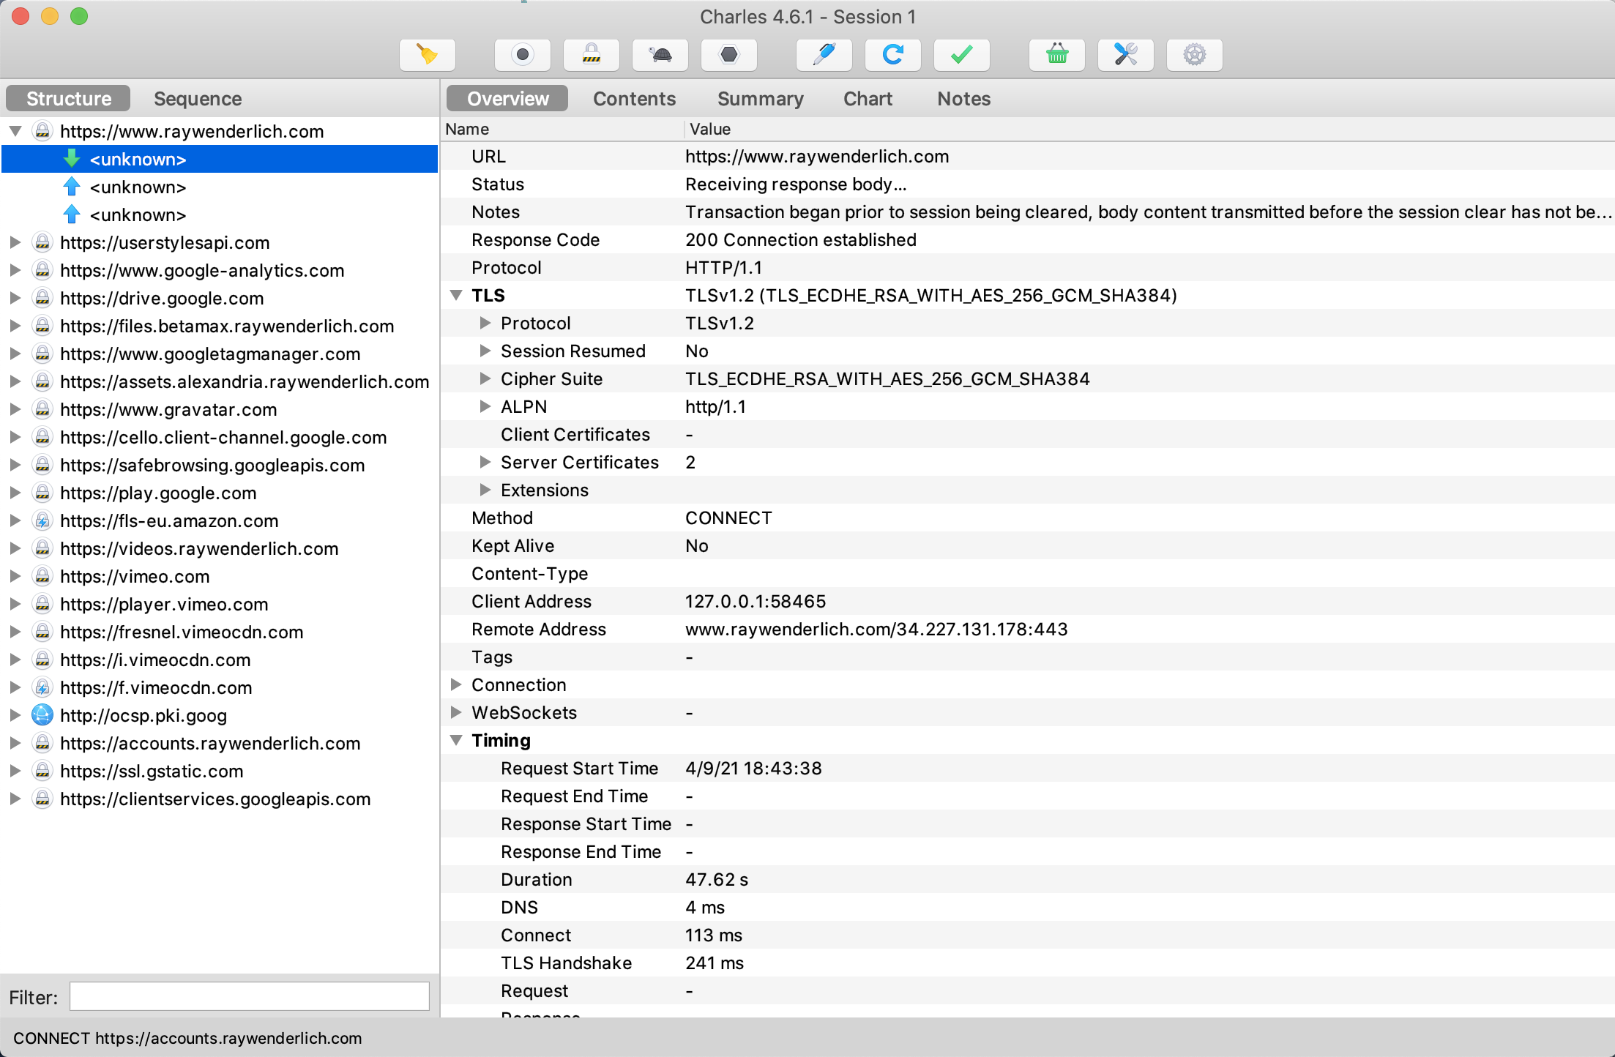
Charles

Slide 26
Emulator
Make /system writeable
Disable secure boot
Disable verity
Mount /system writeable
Copy PEM file to the secure CA store

Slide 27
Dynamic Analysis
openssl x509 -inform PEM -subject_hash_old -in <exported_cert_file>| head -1
emulator -avd Pixel_3a_XL_API_29 -writable-system
adb shell avbctl disable-verification
adb disable-verity
adb remount
mount -o rw,remount /system
/system/etc/security/cacerts/<hash_we_got_above>.0
chmod 644 + chown root:root

Slide 28
Exercise 4
Identify the secondary payload for DawDropper

Slide 29
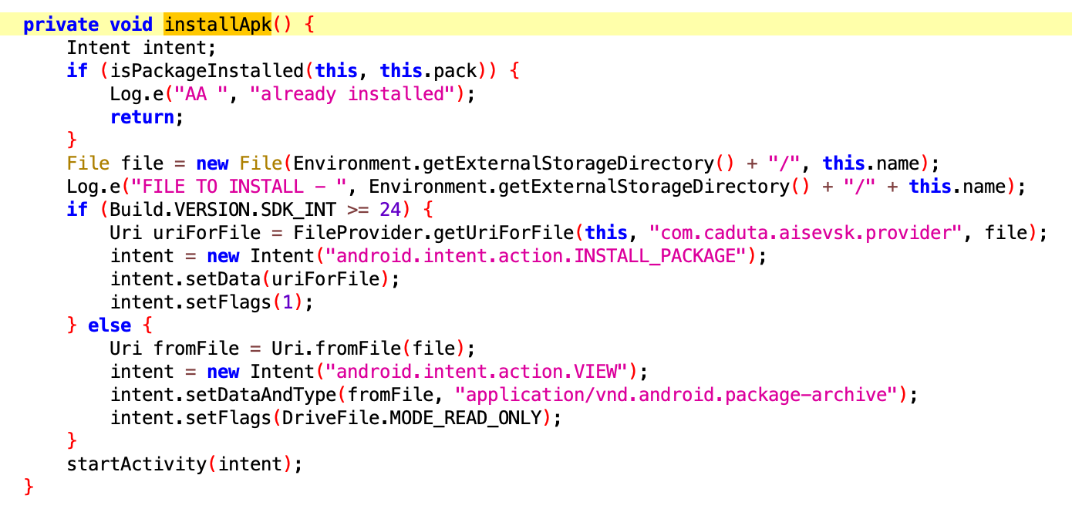
Exercise 4
application/vnd.android.package-archive
Firebase communication
Where is the function called?
What permissions is needed to reach that code path?

Slide 30


Frida
frida-server
localhost:27042
frida-core
Target App
Frida Agent
JS Engine
Frida GUM
Patch
Patch
Patch

Slide 31
Exercise 5
console.log("[*] FRIDA started");
console.log("[*] skip native unlink function");
var unlinkPtr = Module.findExportByName(null, 'unlink');
Interceptor.replace(unlinkPtr, new NativeCallback(function (){
console.log("[*] unlink() encountered,skipping it.");
}, 'int', []));

Slide 32
Exercise 5
Extract the FluBot payload

Slide 33
Exercise 5
console.log("[*] FRIDA started");
console.log("[*] skip native unlink function");
var unlinkPtr = Module.findExportByName(null, 'unlink');
Interceptor.replace(unlinkPtr, new NativeCallback(function (){
console.log("[*] unlink() encountered,skipping it.");
}, 'int', []));

Slide 34
Exercise 6
Trigger Cerberus C2 communications

Slide 35
Exercise 6
Find the secondary payload
Why are the malicious services not active?
What is the code doing?
How can we trigger the codepath necessary for an activation?

Slide 36
Thank you!
github: huuck twitter: @hookgab

